Slide 1
Project N-F plane
How the niche and fitness differences varies across species over multiple years ?

Slide 2
How the niche and fitness differences varies across species over multiple years ?
16 species of annual plants
X
5 consecutives years
(2015,2016,2017,2018,2019)

Slide 3
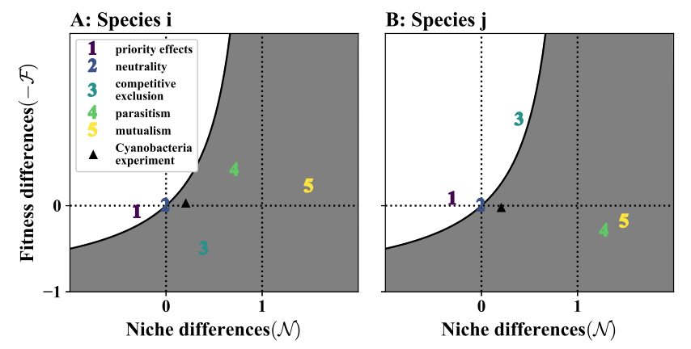
How the niche and fitness differences varies across species over multiple years ?
Spaak and de Laender, 2020, ELE

Slide 4
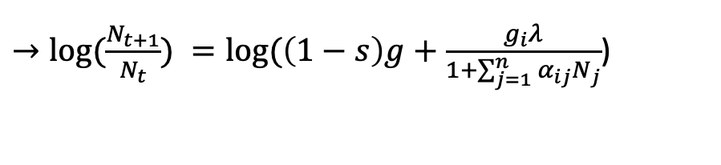
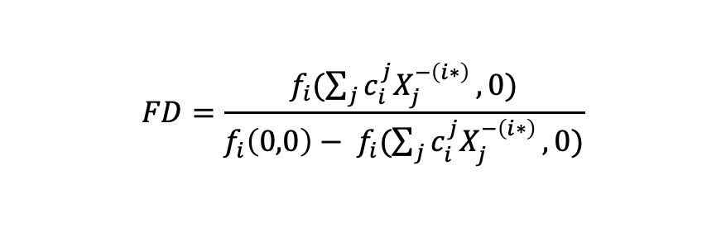
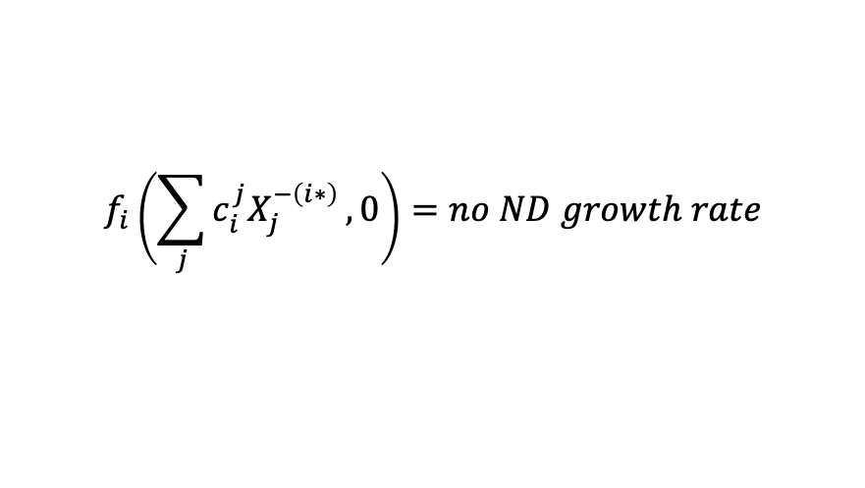
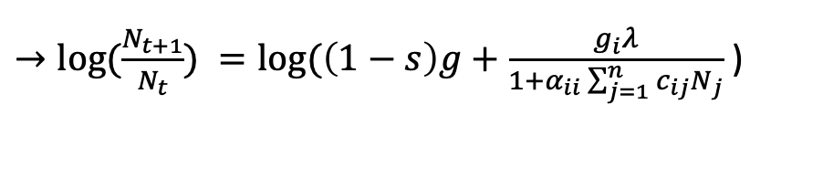
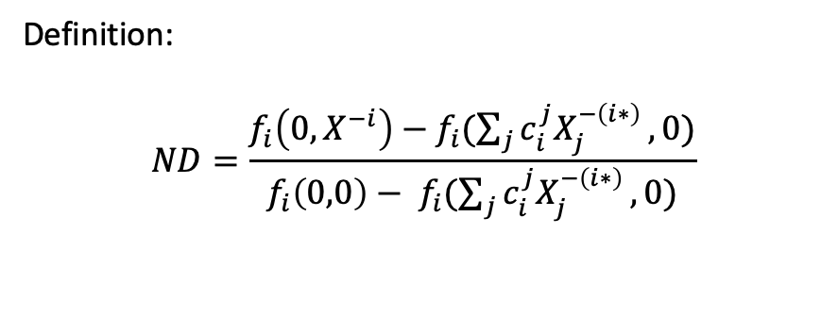

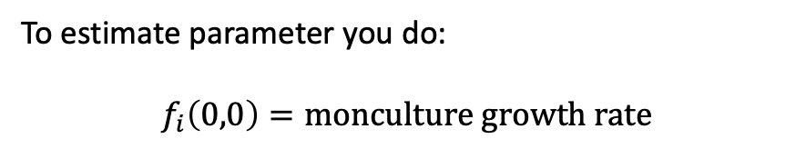
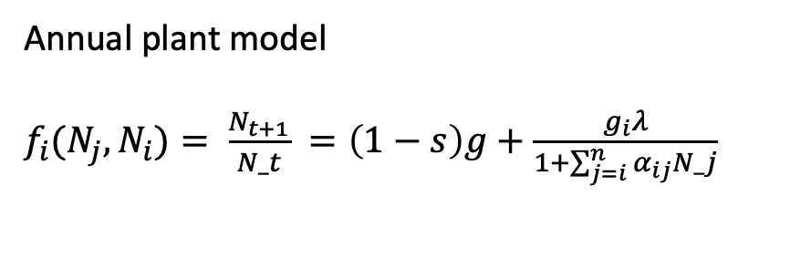
Definition:
$$ND=\frac{f_{i}\left(0, X^{−i}\right)−f_{i}(\sum_{j}{c_{i}^{j}X_{j}^{−\left(i∗\right)}},0)}{{f_{i}\left(0,0\right)− f}_{i}(\sum_{j}{c_{i}^{j}X_{j}^{−\left(i∗\right)}},0)}$$
To estimate parameter you do:
$$f_{i}\left(0,0\right)=monculture growth rate$$
$→log⁡(\frac{N_{t+1}}{N_{t}})=log⁡(\left(1−s\right)g+\frac{g_{i}λ}{1}$ )
$$FD=\frac{f_{i}(\sum_{j}{c_{i}^{j}X_{j}^{−\left(i∗\right)}},0)}{{f_{i}\left(0,0\right)− f}_{i}(\sum_{j}{c_{i}^{j}X_{j}^{−\left(i∗\right)}},0)}$$
$$f_{i}\left(0, X^{−i}\right)=f_{i}\left(0,N_{j}\right)=inv growth rate$$
$→log⁡(\frac{N_{t+1}}{N_{t}}) =log⁡(\left(1−s\right)g+\frac{g_{i}λ}{1+\sum_{j=1}^{n}{α_{ij}}N_{j}}$)
Annual plant model
$f_{i}(N_{j},N_{i})= \frac{N_{t+1}}{N_t} =\left(1−s\right)g+\frac{g_{i}λ}{1+\sum_{j=i}^{n}{α_{ij}N_j}}$
$$f_{i}\left(\sum_{j}{c_{i}^{j}X_{j}^{−\left(i∗\right)}},0\right)=no ND growth rate$$
$→log⁡(\frac{N_{t+1}}{N_{t}}) =log⁡(\left(1−s\right)g+\frac{g_{i}λ}{1+α_{ii}\sum_{j=1}^{n}{c_{ij}}N_{j}}$ )

Slide 5
How the niche and fitness differences varies across species over multiple years ?
Data/NFD_uncert.csv
year | plot | Focal species (seed) | Neighbour 1 (density) | Neighbour 2 (density) | ….
Jürg Spaak
Data/NFD.csv
year | plot | Focal species (id) | N | F | Equilibrium density of species in multispecies community
N.B. For each year, each plot, and each focal species, N and F are estimated 100 times
→ Computation of centroids (+ std error) for each focal species, each year.
Spaak and de Laender, 2020, ELE

Slide 6
How the niche and fitness differences varies across species over multiple years ?
For one species, How do environmental variations change NdFD?
No significant change
Stationary dynamics
Non - stationary dynamics
F
F
F
2
4
2
4
4
1
2
1
3
1
3
3
0
1
N
1
N
N
0
0
1
NFD of the species in the communities during the 3rd year

Slide 7
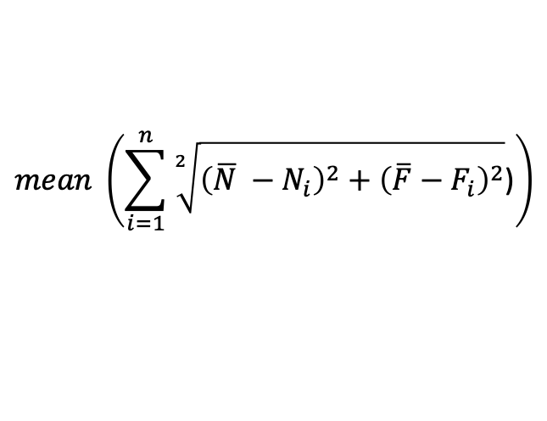
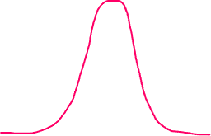

How the niche and fitness differences varies across species over multiple years ?
Within each year, how is the dispersion ( between N and F) of each species?
Across all year, do species have the same dispersion ( between N and F) ?
N.B: dispersion (also called variability, scatter, or spread) is the extent to which a distribution is stretched or squeezed
$$mean \left(\sum_{i=1}^{n}{\sqrt[2]{{\left(\overline{N} −N_{i}\right)}^{2}+{\left(\overline{F}−F_{i}\right)}^{2}}\text{)}}\right)$$
median
Dispersion for one species for one year, n = 100 * 9
Dispersion for one species for all year, n = 100 * 9 * 5 (yrs)
frequency
N
F
N
value

Slide 8
For one species, How do environmental variations change NdFD?
Non - stationary dynamics

Slide 9
For one species, How do environmental variations change NdFD?
Non - stationary dynamics

Slide 10
For one species, How do environmental variations change NdFD?
Non - stationary dynamics
Importance of climate > species identity/traits

Slide 11
Within each year, how is the dispersion ( between N and F) of each species?
Species’ dispersions follow a similar pattern across years

Slide 12
Across all year, do species have the same dispersion ( between N and F) ?
Link with abundances ?

Slide 13
How the niche and fitness differences varies across species over multiple years ?
Future steps :
Find a story
Improve graphs
relation with traits and precipitation --> nfd.dispersion.df_year_traits.csv
Furthers analysis? PCA ?

